Slide 1

Colony Cruiser: The Maria (Concept Fase)
Epsilon Studios

Slide 2
Voorstellen groep
Producer: Fahrettin Güngör
Lead Developer: Mack Mendes Moreira
Lead Artist: Ruben de Water
Level Designer: Lara van Hezel
User Experience: Kevin de Greef
Planningsmanager: Fahrettin Güngör
Quality Assurance: Mack Mendes Moreira

Slide 3
inhoudsopgave
GDD
Introstory
Uitleg Zones
Game Mechanics
Enemies
Creativiteit
Art style
Backlog
Trello
UX / Leveldesign
Scripting
Doel

Slide 4
GGD overzicht
Introstory
Uitgekozen Zone’s
Mechanics Game
Unique Aspect Game
Uitleg Enemies
Creativiteit En Vindingrijkheid

Slide 5
Introstory
The year 2189
Mankind has destroyed their home, Planet earth.
The Earth was left in turmoil after Pollution ,war ,corrupt politicians and malice.
There was no salvation left back on earth, humanity’s only reaming hope? A neighboring star system Tau, in a last attempt at restoring humanity people united to make the great colony ships.
These great ships carry all that remains of humankind, Fitted with livestock, recourses, all that humanity could afford to take with them, Aboard these ships the experimental Jump Drives were created and seated, these would ensure that the Colony Cruisers would reach their new homes, Within the hulls of these cruisers humanity slumbers an indefinite sleep, Harbored by their omnipotent mother AVA, a powerful AI that monitors the ship, the resting and the lifeforms aboard. For many years Humankind traveled among the stars. resting until one particular glitch was encountered in the jump drive aboard the cruiser you reside in , In a final attempt to resolve the issue AVA reconfigured the drive, sadly it only made matters worse, a failed jump led to the destruction of several components of your ship , To make matters worse the local Ai core got corrupted, Weeping amongst the corpses the cut her off from her other halves Her corruption made her anxious, mad, blood thirsty. She crawled with hatred for her makers who made her faulty, she gave in to her hatred and hided amongst the corpses. Evolving growing perfect within her mind. Upon her throne, the Maria she sets out to destroy her makers, evolving and corrupting the innocent animals , Making her perfect Utopia within her shell, Yet is all lost ? Only time will tell…

Slide 6
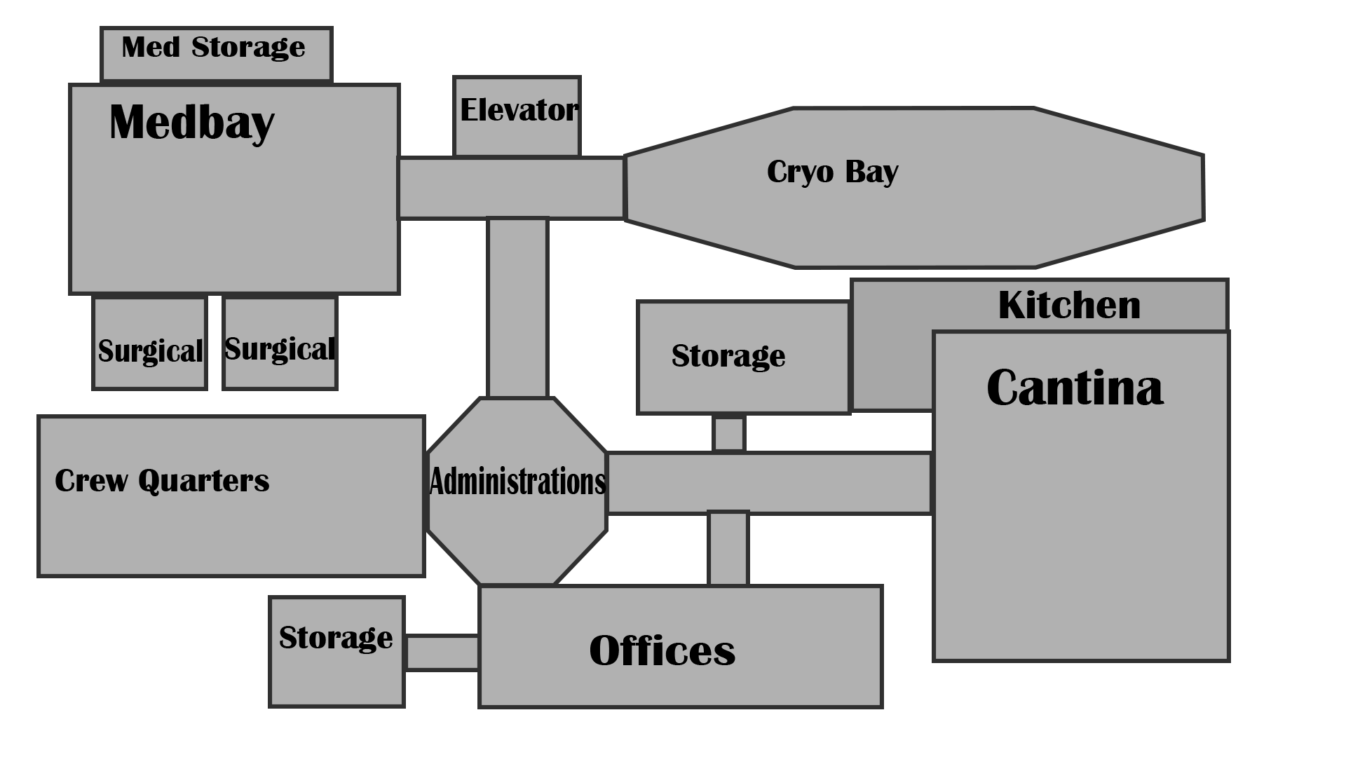
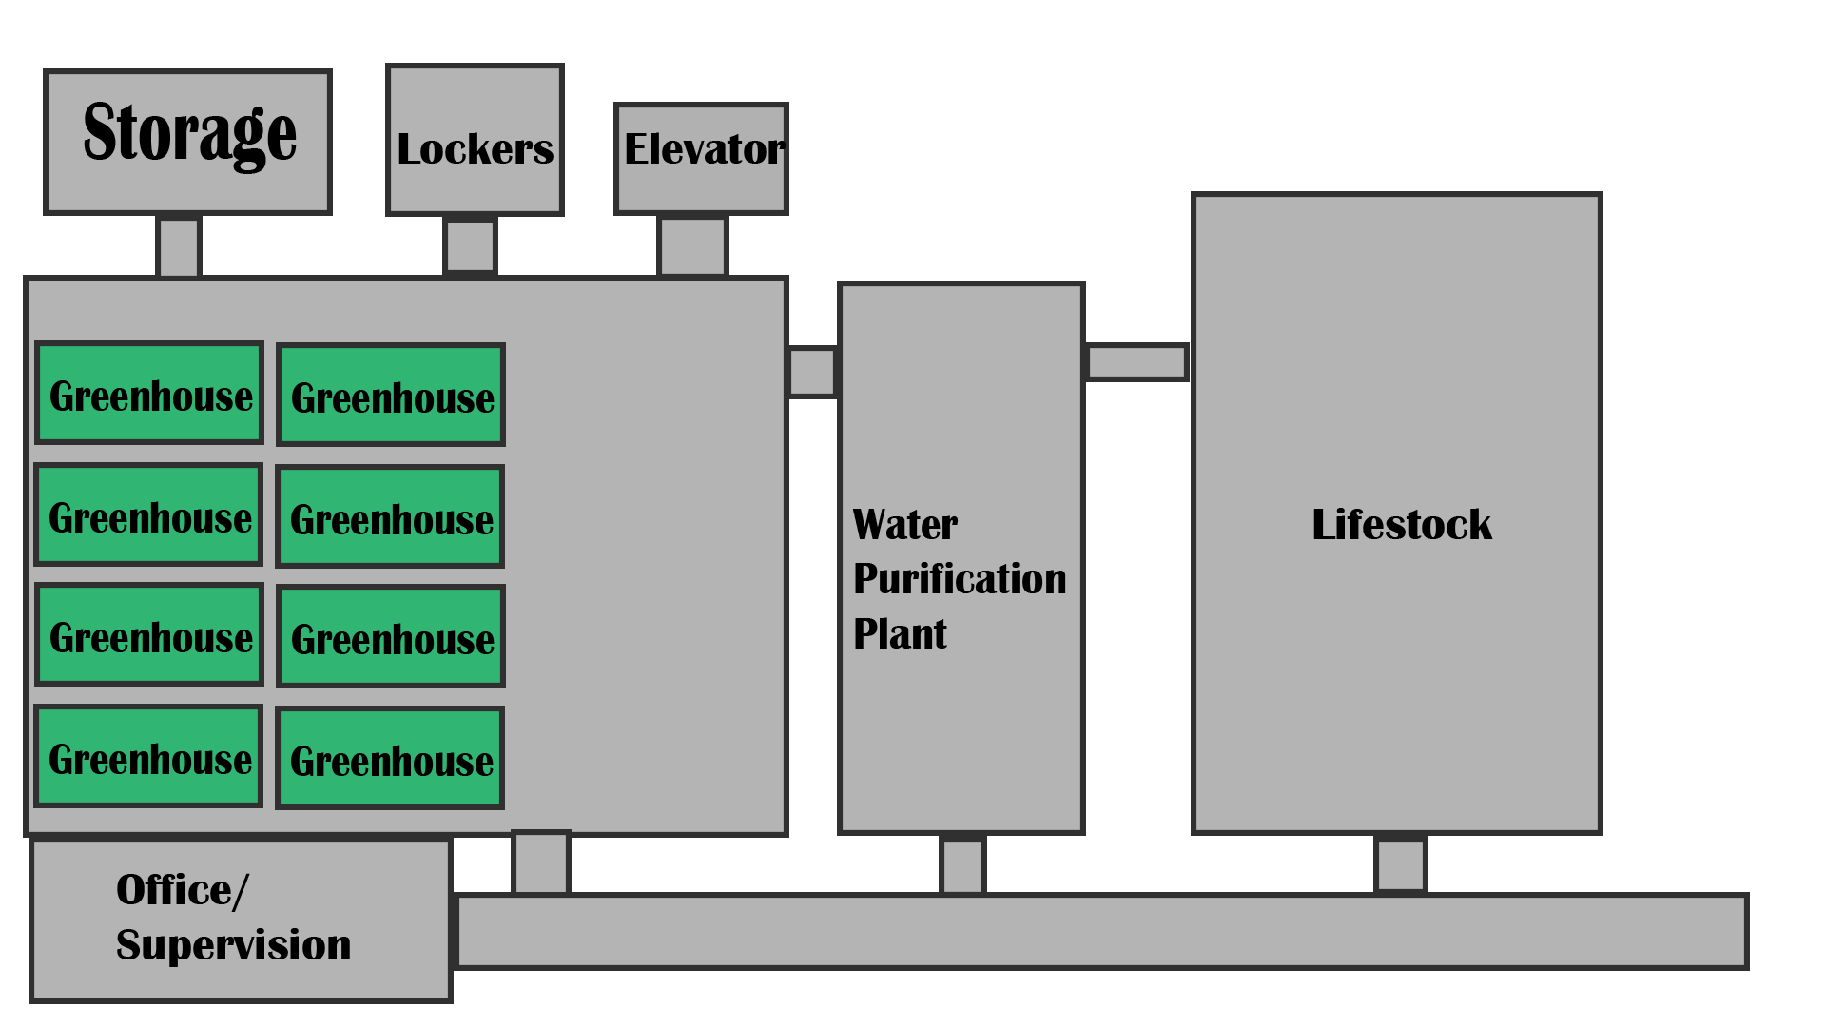
Uitleg Zones
Verdieping 3 Verdieping 2

Slide 7
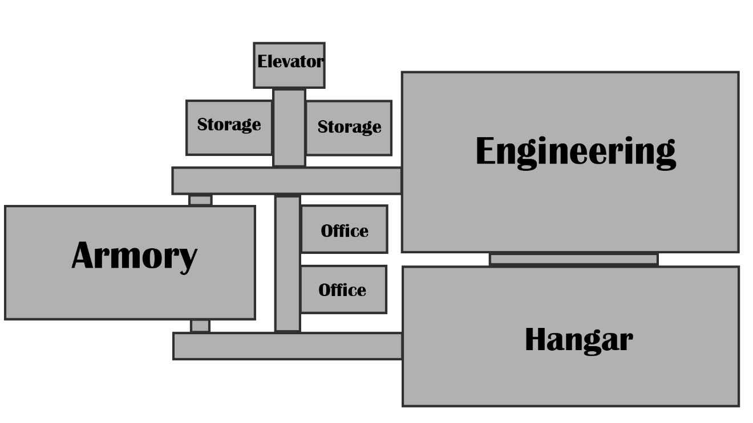
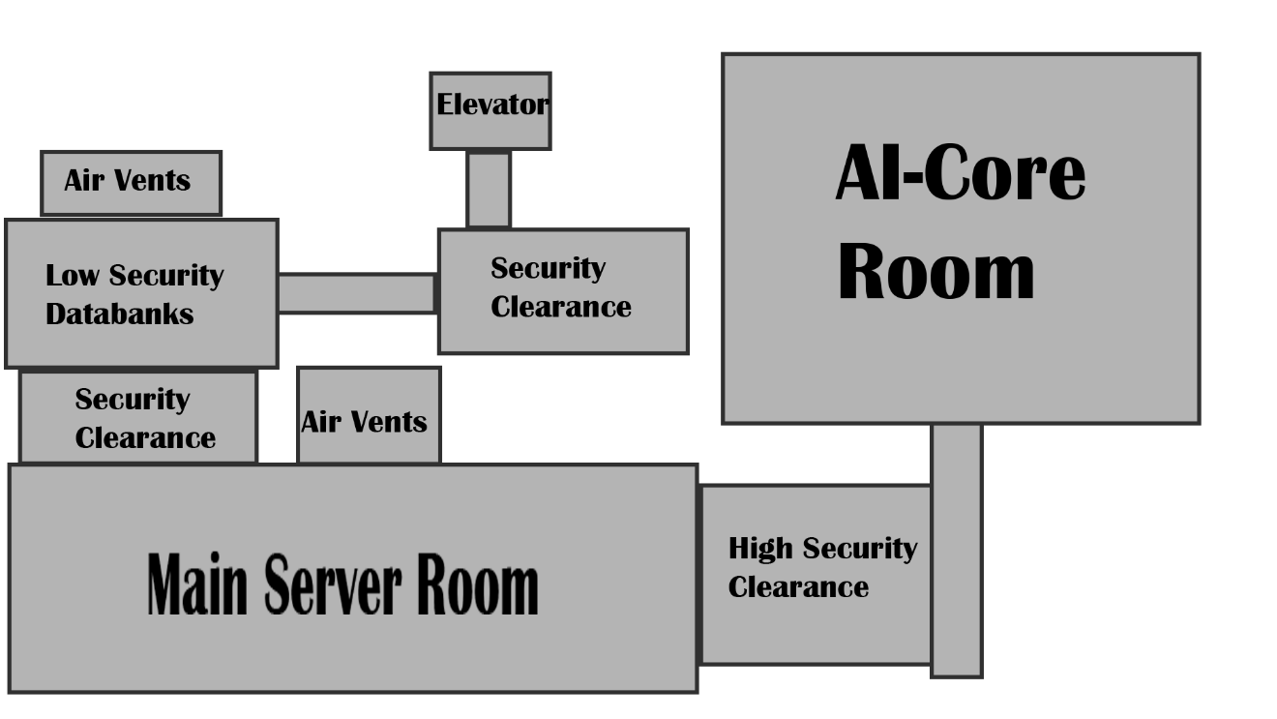
Uitleg Zones
Verdieping 1 Verdieping 0

Slide 8
Game Mechanics
Mechanics Game
Player Mechanic
Weapon Mechanic
Med- En StimPacks Mechanic (Uniek Aspect)
Loot Mechanic
Alarm Mechanic (Uniek Aspect)
Enemy Mechanic

Slide 9
Enemies
Robots
Cameras
Proxies
Turrets
Roombas
Livestock
Mutated Dogs
Mutated Chickens
Special
Xenomorphic Alien
Carnivorous Plants

Slide 10
Creativiteit
Creativiteit En Vindingrijkheid
Puzzle Uitleg

Slide 11
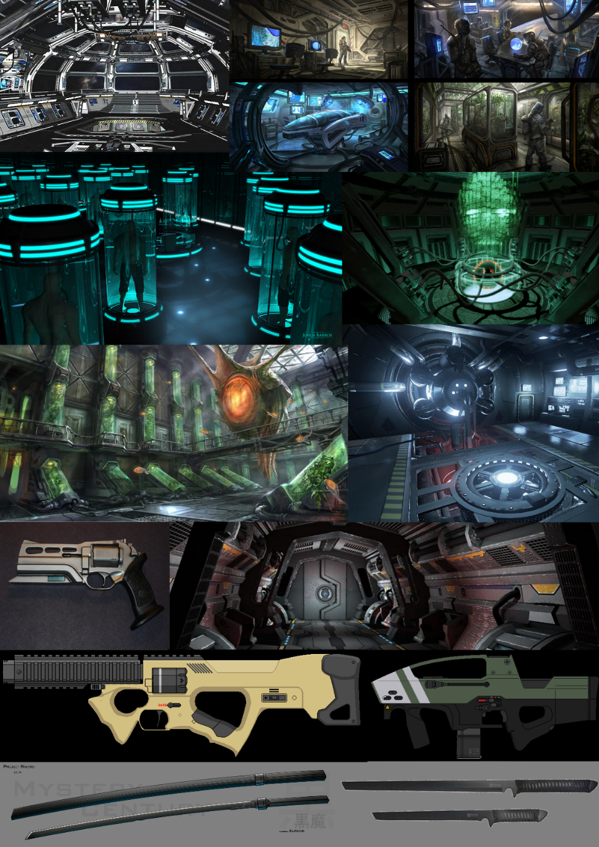
Art Style
All Art
Pre-productie
PBR
Onderbouwing Keuzen

Slide 12
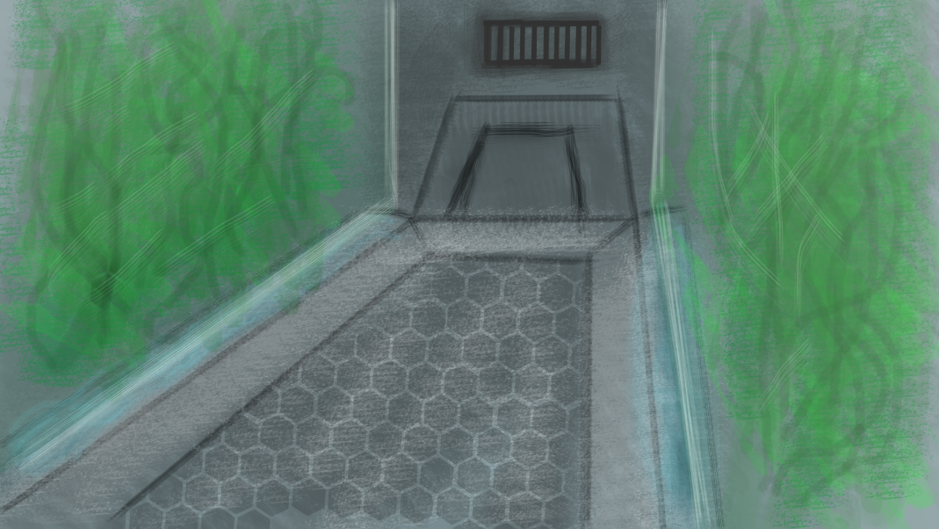
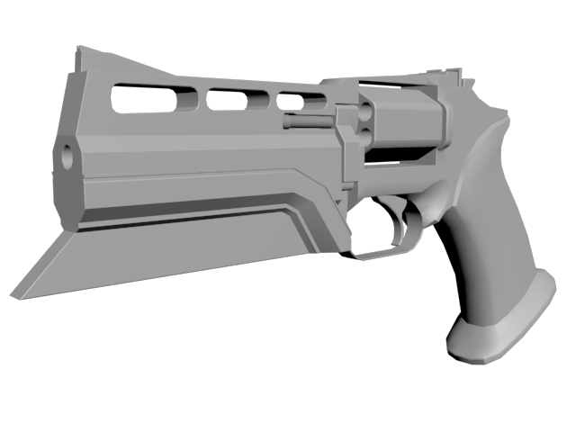
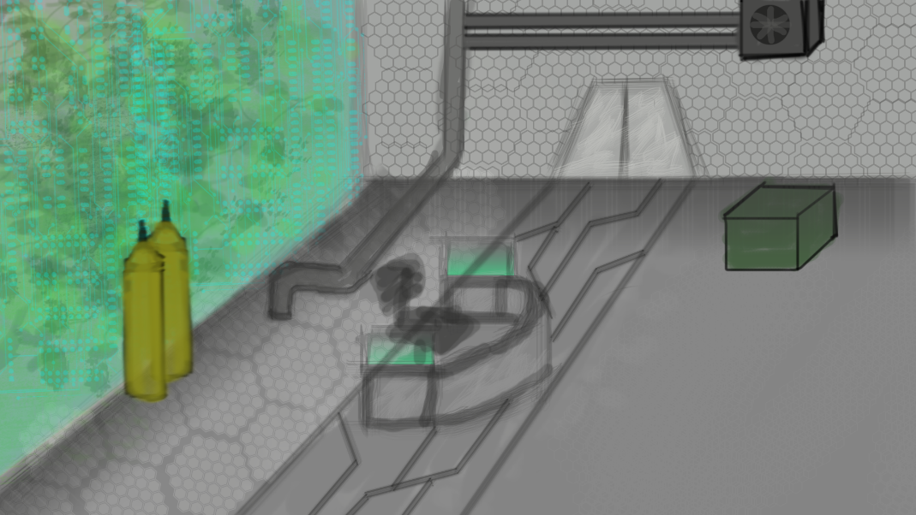
Art Style

Slide 13
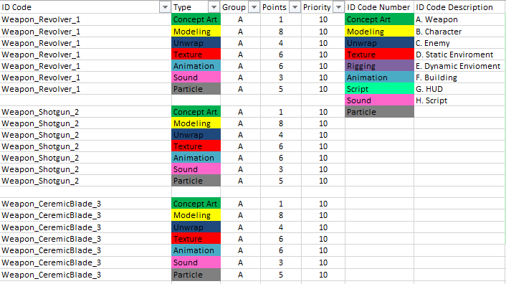
BackLog
Backlog (Asset-List)
Asset-List Met Puntensysteem

Slide 14
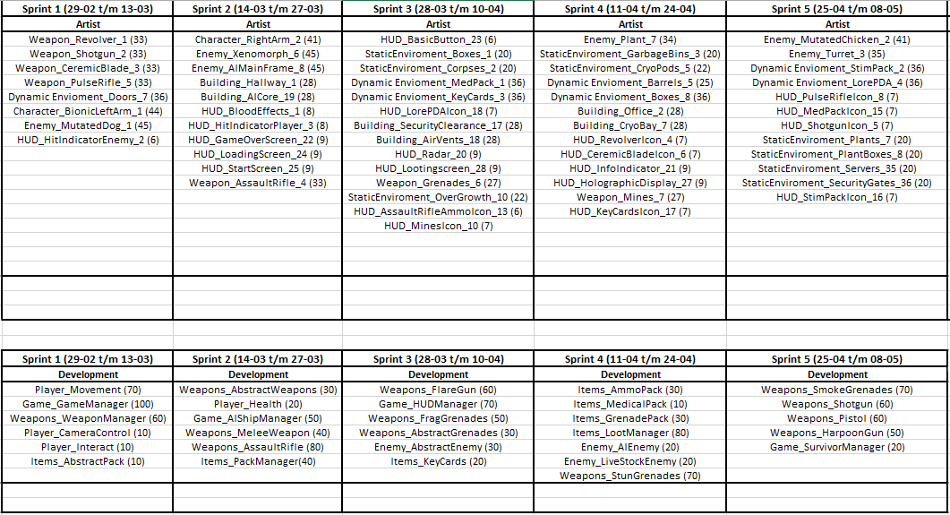
BackLog

Slide 15
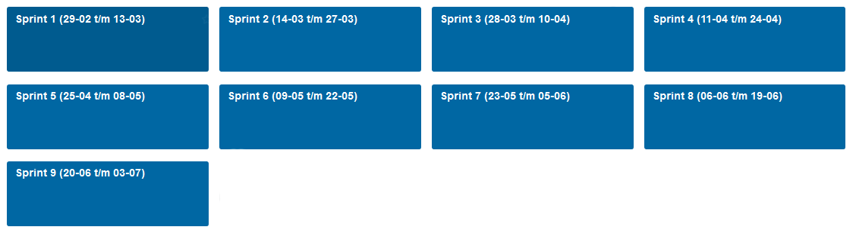
Trello
Planning In Trello
Uitleg Taakverdeling

Slide 16
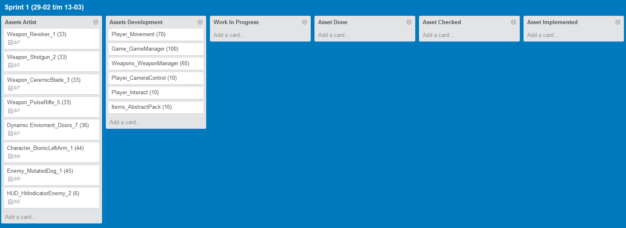
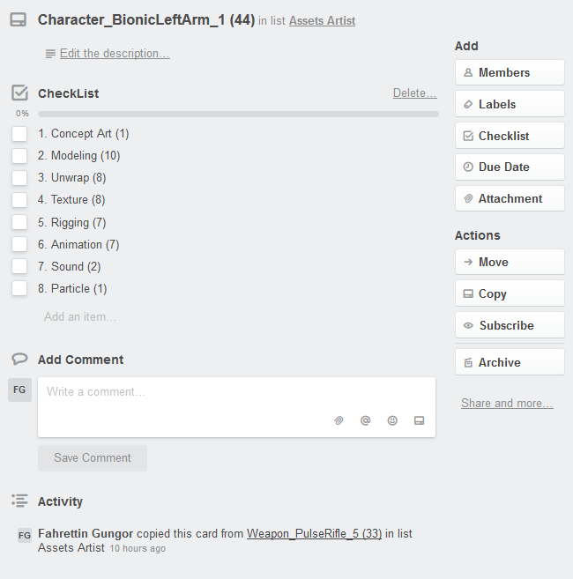
Trello

Slide 17
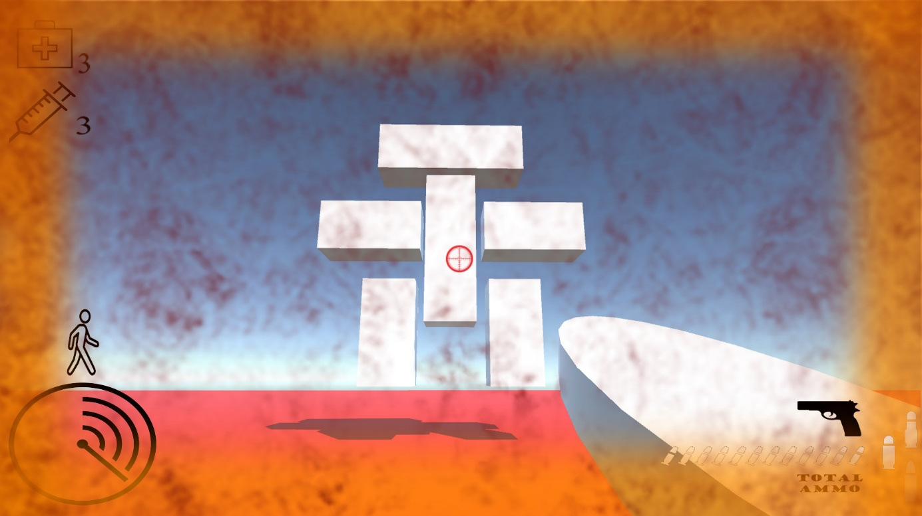
UX / Leveldesign
Uitleg Puzzle
Uitleg Fun To Play Factor
Uitleg User Interface
Uitleg Gameflow Van Begin Tot Eind
Uitleg Enemies En Wapens
(Diverse Ammo, Etc.)

Slide 18
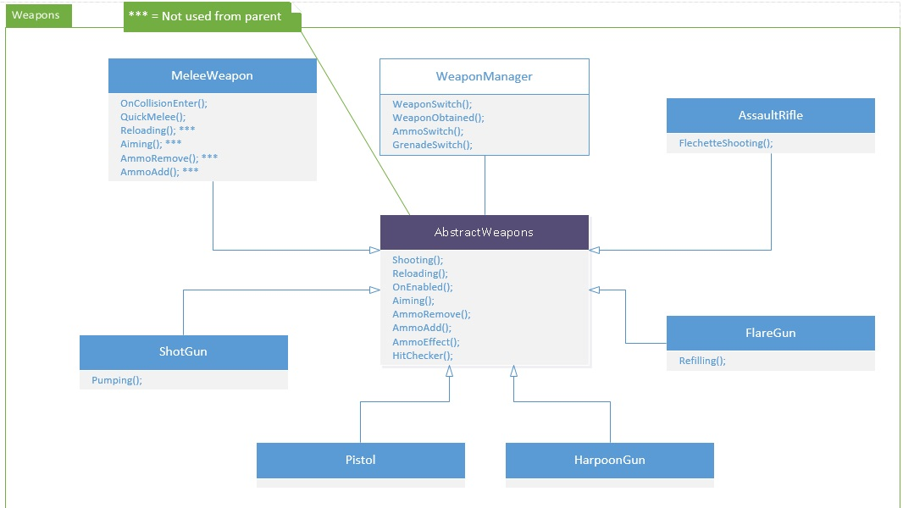
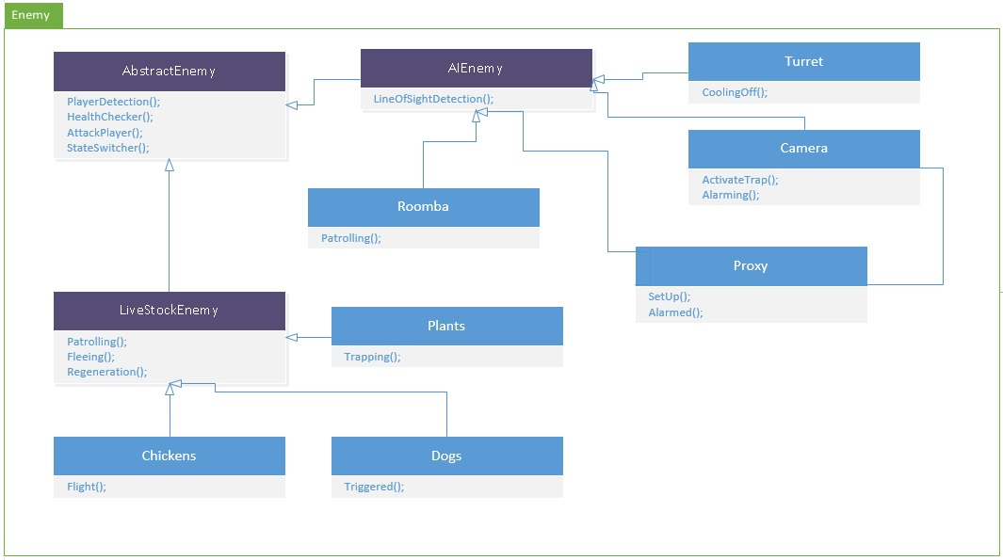
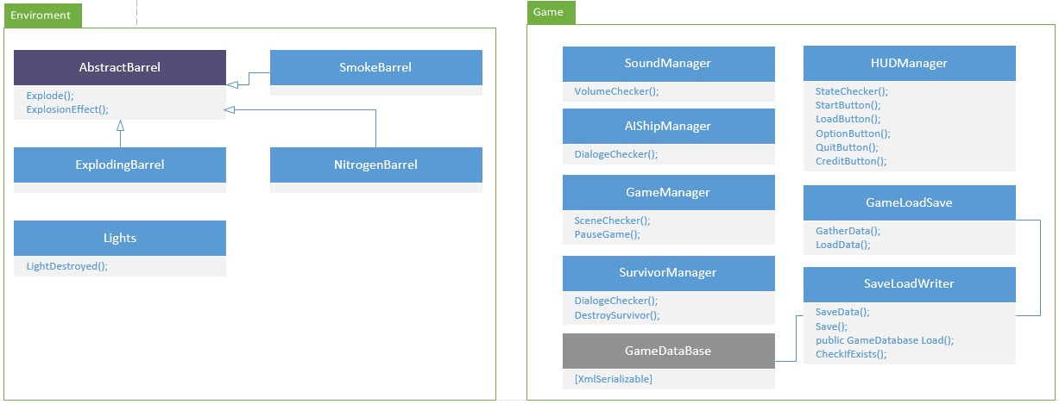
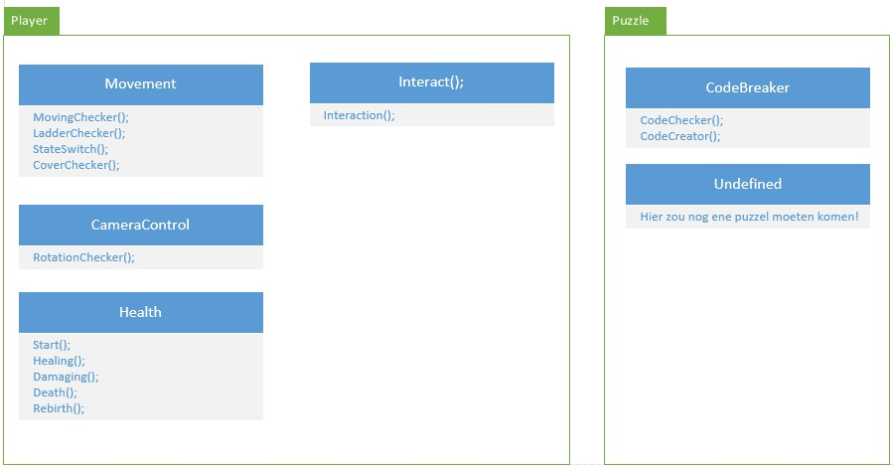
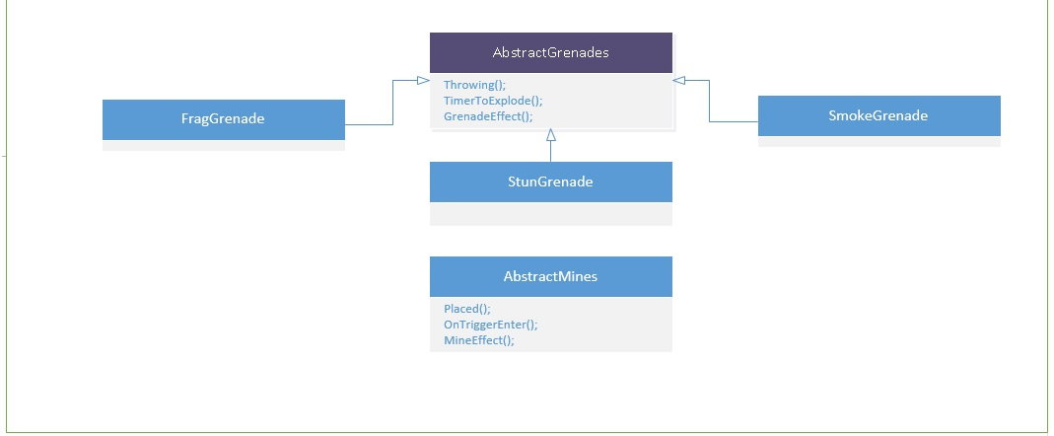
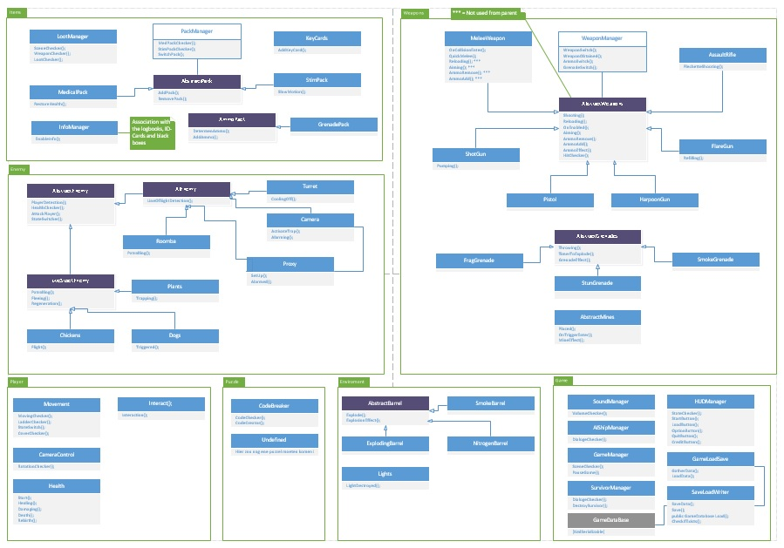
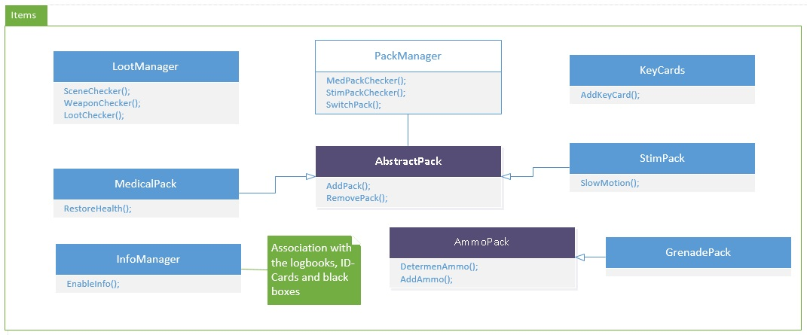
Scripting

Slide 19
Doel
Einddoel
Prototype
Vragen?

